Slide 1
Speech Recognition
Training Continuous Density HMMs
Lecture Based on:
Dr. Rita Singh’s Notes
School of Computer Science
Carnegie Mellon University

Slide 2
Table of Content
Review of continuous density HMMs
Training context independent sub-word units
  Outline
  Viterbi training
  Baum-Welch training
Training context dependent sub-word units
  State tying
  Baum-Welch for shared parameters
Veton Këpuska

Slide 3
Discrete HMM
Data can take only a finite set of values
  Balls from an urn
  The faces of a dice
  Values from a codebook
The state output distribution of any state is a normalized histogram
Every state has its own distribution
HMM outputs one of four colors at each instant.
Each of the three states has a different probability distribution for the colors.
Since the number of colors is discrete, the state output distributions are multinomial.
Veton Këpuska

Slide 4
Continuous Density HMM
There data can take a continuum of values:
  e.g., cepstral vectors
Each state has a state output density.
When the process visits a state, it draws from the state output density for that state.
HMM outputs a continuous valued random variable at each state.
State output densities are mixtures of Gaussians.
The output at each state is drawn from this mixture.
Veton Këpuska

Slide 5
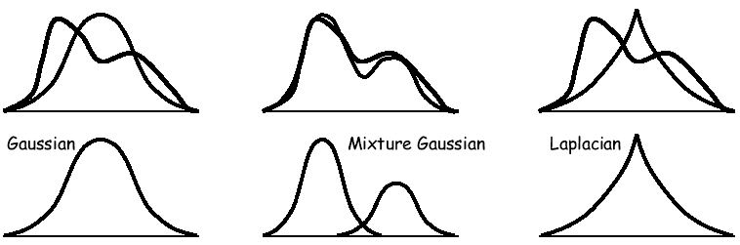
Modeling Output State Densities
The state output distributions might be anything in reality
We model these state output distributions using various simple densities
  The models are chosen such that their parameters can be easily estimated
  Gaussian
  Mixture Gaussian
  Other exponential densities
If the density model is inappropriate for the data, the HMM will be a poor statistical model
  Gaussians are poor models for the distribution of power spectra
Veton Këpuska

Slide 6
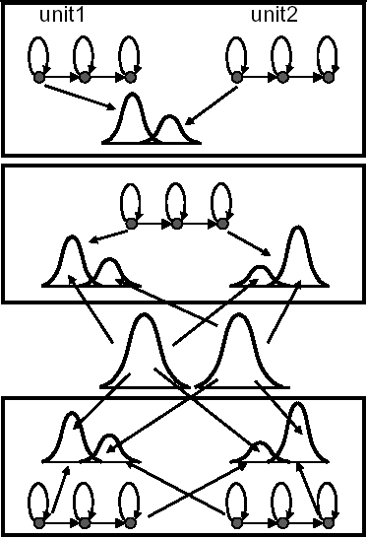
Parameter Sharing
Insufficient data to estimate all parameters of all Gaussians
Assume states from different HMMs have the same state output distribution
  Tied-state HMMs
Assume all states have different mixtures of the same Gaussians
  Semi-continuous HMMs
Assume all states have different mixtures of the same Gaussians and some states have the same mixtures
  Semi-continuous HMMs with tied states
Other combinations are possible
Veton Këpuska

Slide 7
Training Models for a Sound Unit
Training involves grouping data from sub-word units followed by parameter estimation.
AX
AC
F AC K S IH N S AC K S AC N B AC K S AC N N AC K S
FOX IN SOCKS ON BOX ON KNOX
Veton Këpuska

Slide 8
Training models for a sound unit
Training involves grouping data from sub-word units followed by parameter estimation
Indiscriminate grouping of vectors of a unit from different locations in the corpus results in Context-Independent (CI) models
Explicit boundaries (segmentation) of sub-word units not available
  We do not know where each sub-word unit begins or ends
Boundaries must be estimated
For a 5-state HMM, segment data from each instance of sub-word unit to 5 parts, aggregate all data from corresponding parts, and find the statistical parameters of each of the aggregates
Veton Këpuska

Slide 9
Learning HMM Parameters
Viterbi training
  Segmental K-Means algorithm
  Every data point associated with only one state
Baum-Welch
  Expectation Maximization algorithm
  Every data point associated with every state, with a probability
    A (data point, probability) pair is associated with each state
Veton Këpuska

Slide 10
Viterbi Training
Initialize all HMM parameters
For each training utterance, find best state sequence using Viterbi algorithm
Bin each data vector of utterance into the bin corresponding to its state according to the best state sequence
Update counts of data vectors in each state and number of transitions out of each state
Re-estimate HMM parameters
  State output density parameters
  Transition matrices
  Initial state probabilities
If the likelihoods have not converged, return to step 2.
Veton Këpuska

Slide 11
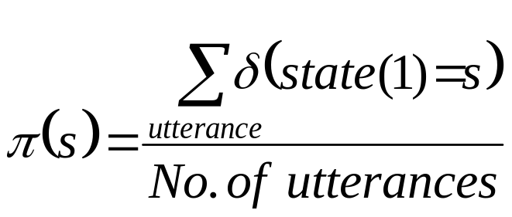
Viterbi Training: Estimating Model Parameters
Initial State Probability
  Initial state probability π(s) for any state s is the ratio of the number of utterances for which the state sequence began with s to the total number of utterances.
Veton Këpuska

Slide 12
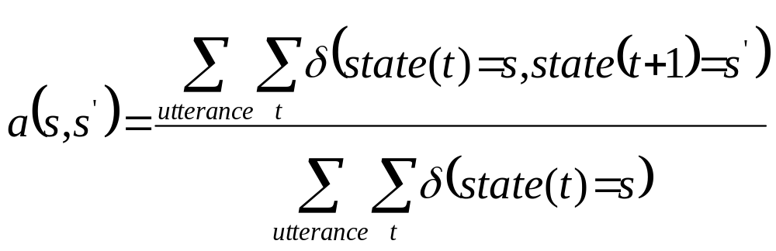
Viterbi Training: Estimating Model Parameters
Transition probabilities
  The transition probability a(s,s’) of transiting from state s to s’ is the ratio of the number of observations from state s, for which the subsequent observation was from state s’, to the number of observations that were in s
Veton Këpuska

Slide 13
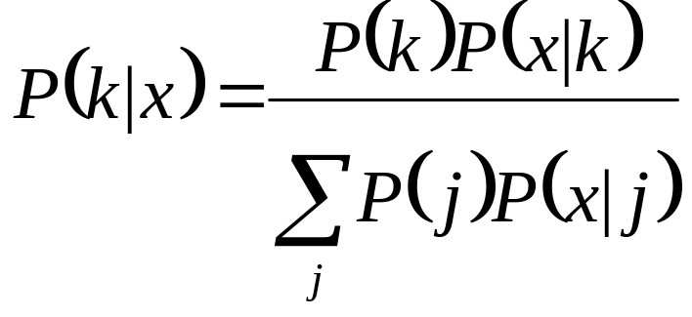
Viterbi Training: Estimating Model Parameters
State output density parameters
  Use all the vectors in the bin for a state to compute its state output density
  For Gaussian state output densities only the means and variances of the bins need be computed
  For Gaussian mixtures, iterative EM estimation of parameters is required within each Viterbi iteration
Posterior probability of k^{th} Gaussian given observation x.
P(x|k) is a Gaussian.
Veton Këpuska

Slide 14
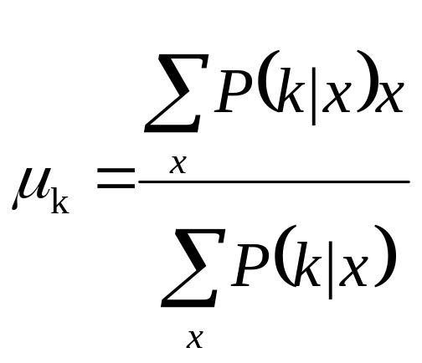
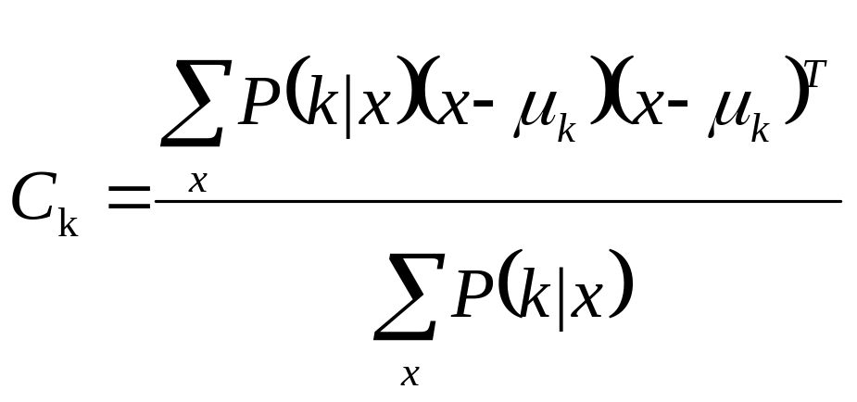
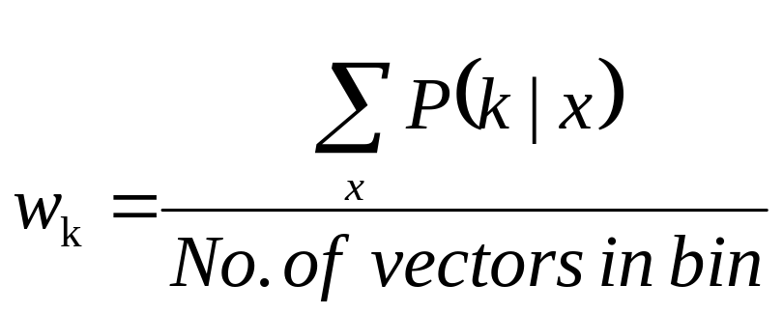
Viterbi Training: Estimating Model Parameters
Mean of k^{th} Gaussian
Covariance of k^{th} Gaussian
Mixture weight of k^{th} Gaussian
Veton Këpuska

Slide 15
Baum-Welch Training
Initialize HMM parameters
On each utterance run forward backward to compute following terms:
  γ_{utt}(s,t) = a posteriori probability given the utterance, that the process was in state s at time t
  γ_{utt}(s,t,s’,t+1) = a posteriori probability given the utterance, that the process was in state s at time t, and subsequently in state s’ at time t+1
Re-estimate HMM parameters using gamma terms
If the likelihood of the training set has not converged, return to step 2.
Veton Këpuska

Slide 16
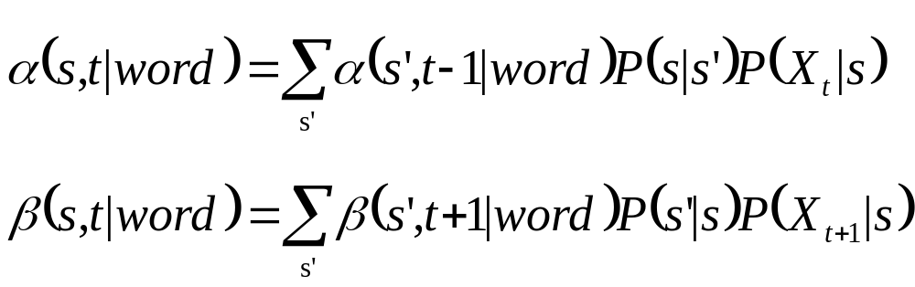
Baum-Welch: Computing A Posteriori State Probabilities and Other Counts
Compute α and β terms using the forward backward algorithm
Veton Këpuska

Slide 17
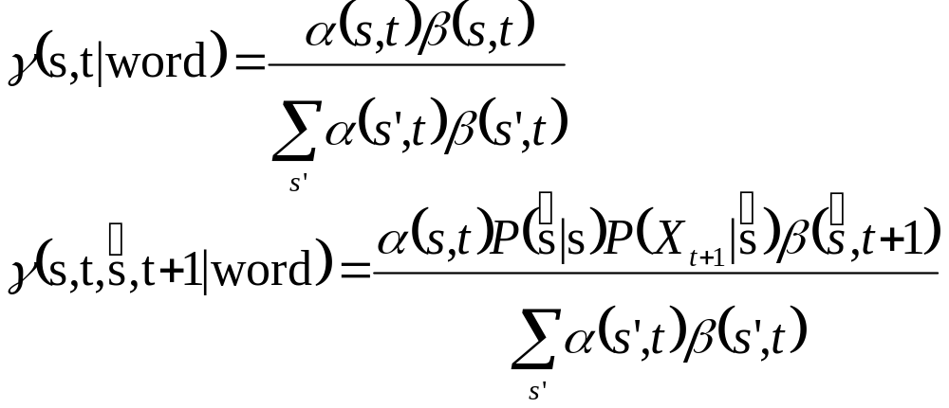
Baum-Welch: Computing A Posteriori State Probabilities and Other Counts
Compute a posteriori probabilities of states and state transitions using α and β values
Veton Këpuska

Slide 18
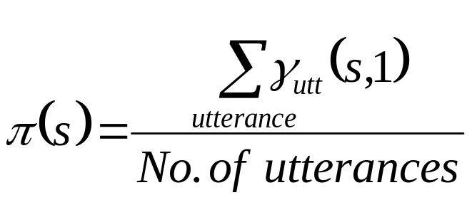
Baum-Welch: Estimating Model Parameters
Initial State Probability
  Initial state probability π(s) for any state s is the ratio of the expected number of utterances for which the state sequence began with s to the total number of utterances
Veton Këpuska

Slide 19
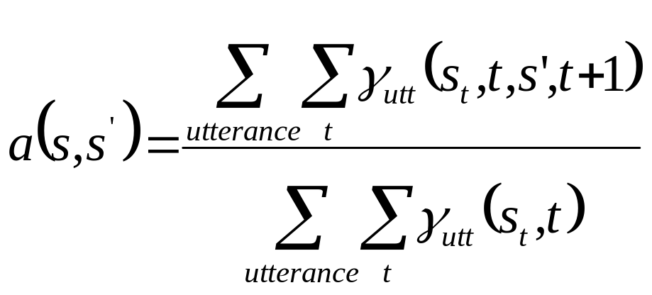
Baum-Welch: Estimating Model Parameters
Transition probabilities
  The transition probability a(s,s’) of transiting from state s to s’ is the ratio of the expected number of observations from state s for which the subsequent observation was from state s’, to the expected number of observations that were in s
Veton Këpuska

Slide 20
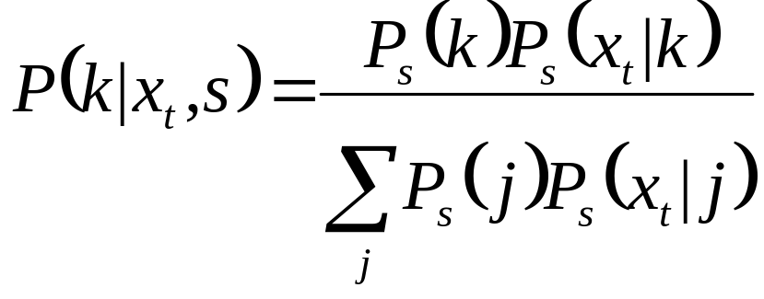
Baum-Welch: Estimating Model Parameters
State output density parameters
  The a posteriori state probabilities are used along with a posteriori probabilities of the Gaussians as weights for the vectors
  Means, covariances and mixture weights are computed from the weighted vectors
Posterior probability of k^{th} Gaussian given observation x.
P(x|k) is a Gaussian.
Veton Këpuska

Slide 21
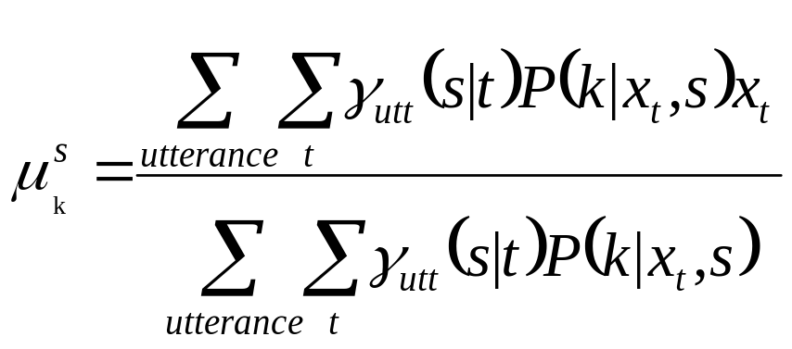
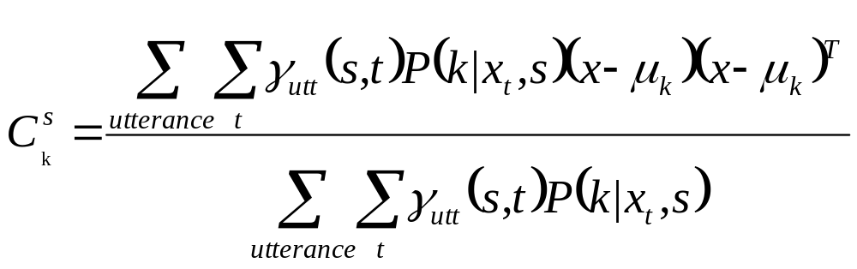
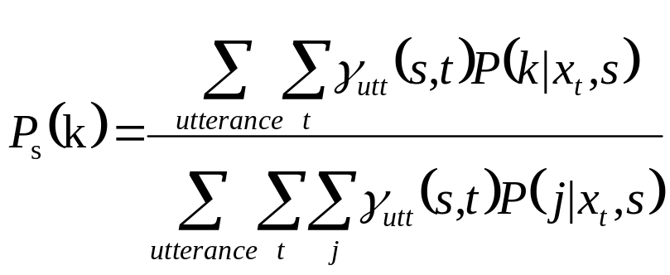
Baum-Welch: Estimating Model Parameters
Mean of k^{th} Gaussian
of state s
Covariance of k^{th} Gaussian
of state s
Mixture weight of k^{th} Gaussian
of state s
Veton Këpuska

Slide 22
Training Context Dependent (Triphone) Models
Context based grouping of observations results in finer, Context-Dependent (CD) models
CD models can be trained just like CI models, if no parameter sharing is performed
Usually insufficient training data to learn all triphone models properly
  Parameter estimation problems
Parameter estimation problems for CD models can be reduced by parameter sharing. For HMMs this is done by cross-triphone, within-state grouping
Veton Këpuska

Slide 23
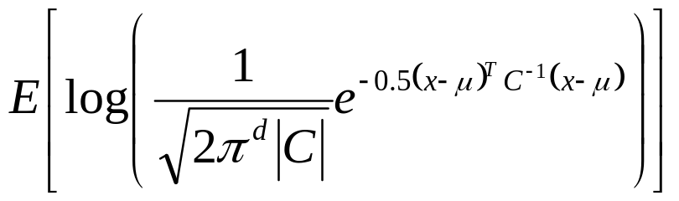
Grouping of context-dependent units for parameter estimation
Partitioning any set of observation vectors into two groups increases the average (expected) likelihood of the vectors
The expected log-likelihood of a vector drawn from a Gaussian distribution with mean μ and variance C is
The assignment of vectors to states can be done using previously trained CI models or with CD models that have been trained without parameter sharing
Veton Këpuska

Slide 24
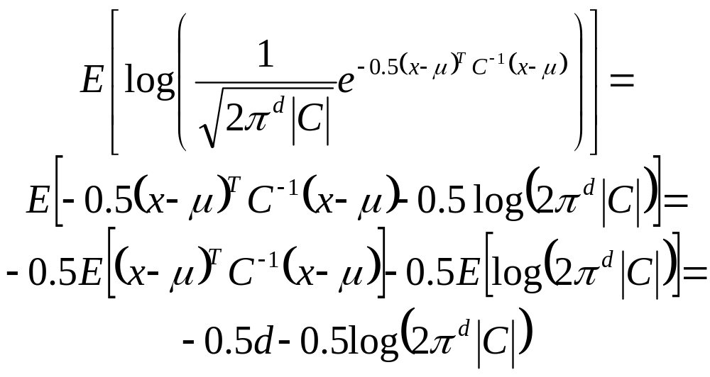
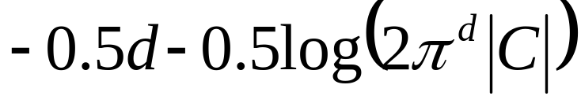
Expected log-likelihood of a vector drawn from a Gaussian distribution
This is a function only of the variance of the Gaussian
The expected log-likelihood of a set of N vectors is
Veton Këpuska

Slide 25
Grouping of context-dependent units for parameter estimation
If we partition a set of N vectors with mean μ and variance C into two sets of vectors of size N₁ and N₂ , with means μ₁ and μ₂ and variances C₁ and C₂ respectively, the total expected log-likelihood of the vectors after splitting becomes
The total log-likelihood has increased by
Veton Këpuska

Slide 26
Grouping of context-dependent units for parameter estimation
Observation vectors partitioned into groups to maximize within class likelihoods
Recursively partition vectors into a complete tree
Prune out leaves until desired number of leaves obtained
The leaves represent tied states (sometimes called senones)
  All the states within a leaf share the same state distribution
2^{n-1} possible partitions for n vector groups. Exhaustive evaluation too expensive
Linguistic questions used to reduce search space
Veton Këpuska

Slide 27
Linguistic Questions
Linguistic questions are pre-defined phone classes. Candidate partitions are based on whether a context belongs to the phone class or not
Linguistic question based clustering also permits us to compose HMMs for triphones that were never seen during training (unseen triphones)
Veton Këpuska

Slide 28
Composing HMMs for unseen triphones
For every state of the N-state HMM for the unseen triphone, locate appropriate leaf of the tree for that state
Locate leaf by answering the partitioning questions at every branching of the tree
Vowel?
S or Z?
Veton Këpuska

Slide 29
Linguistic Questions
Linguistic questions are pre-defined phone classes. Candidate partitions are based on whether a context belongs to the phone class or not
Linguistic question based clustering also permits us to compose HMMs for triphones that were never seen during training (unseen triphones)
Linguistic questions must be meaningful in order to deal effectively with unseen triphones
Meaningful Linguistic Questions?
  Left Context: (A,E,I,Z,SH)
  ML Partition: (A,E,I) (Z,SH)
  (A,E,I) vs. Not (A,E,I)
  (A,E,I,O,U) vs Not (A,E,I,O,U)
A
I
Z
E
SH
Linguistic questions can be automatically designed by clustering of context-independent models.
Veton Këpuska

Slide 30
Other forms of parameter sharing
Ad-hoc sharing: sharing based on human decision
  Semi-continuous HMMs – all state densities share the same Gaussians
  This sort of parameter sharing can coexist with the more refined sharing described earlier.
Veton Këpuska

Slide 31
Baum-Welch: Sharing Model Parameters
Model parameters are shared between sets of states
  Update formulae are the same as before, except that the numerator and denominator for any parameter are also aggregated over all the states that share the parameter
Veton Këpuska

Slide 32
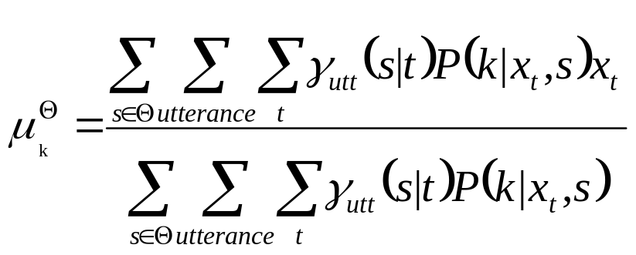
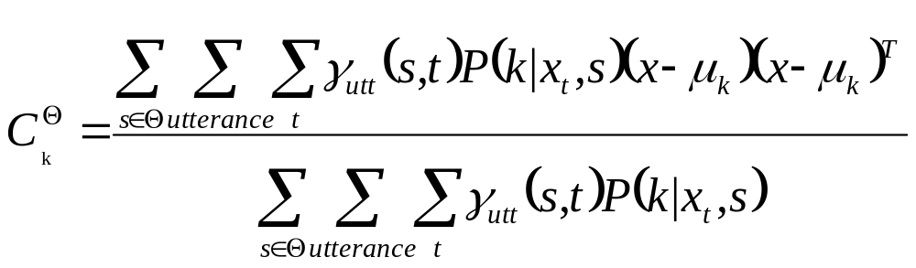
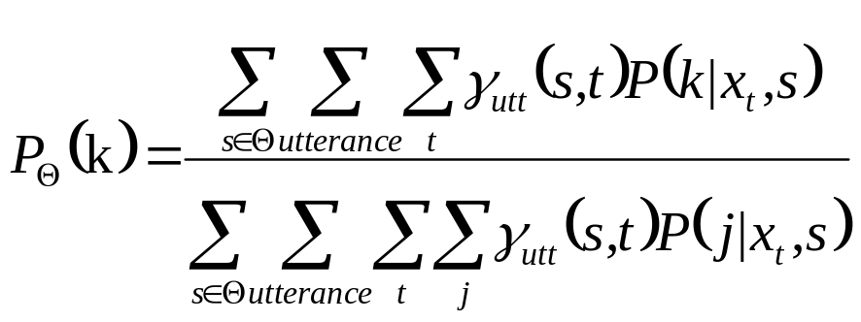
Baum-Welch: Sharing Model Parameters
Mean of k^{th} Gaussian of any state in the set of states Θ that share the k^{th} Gaussian
Covariance of k^{th} Gaussian of any state in the set of states Θ that share the k^{th} Gaussian
Mixture weights of k^{th} Gaussian of any state in the set of states Θ that share the k^{th} Gaussian mixture
Veton Këpuska

Slide 33
Conclusions
Continuous density HMMs can be trained with data that have a continuum of values
To reduce parameter estimation problems, state distributions or densities are shared
Parameter sharing has to be done in such a way that discrimination between sounds is not lost, and new sounds are accounted for
  Done through regression trees
HMMs parameters can be estimated using either Viterbi or Baum-Welch training
Veton Këpuska

